Slide 1
Leadership
Didi Sundiman

Slide 2
Leadership ?
Kepemimpinan

Slide 3

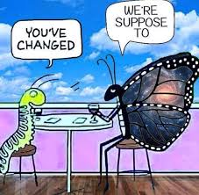
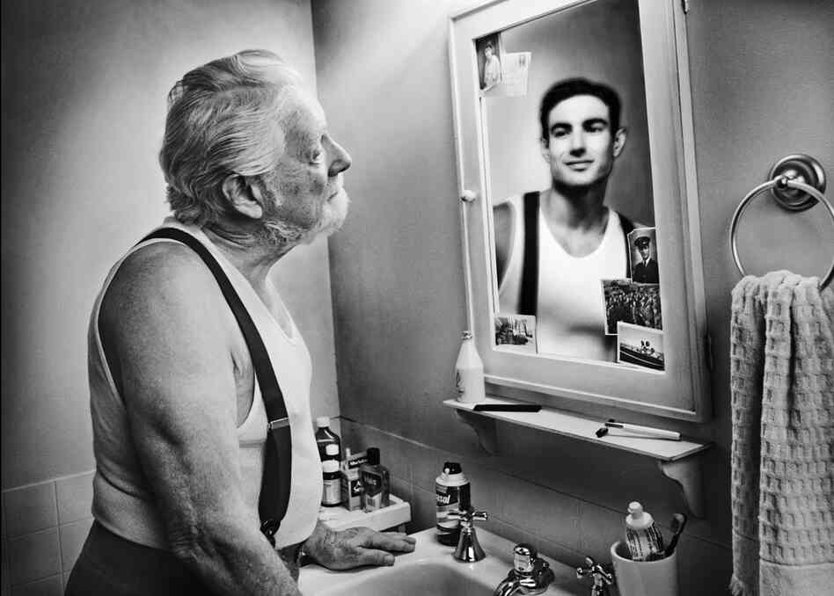
Three keys for Sustainable Leadership
Three keys for Sustainable Leadership
know who am I
sense of adaptability
influencing the younger leaders

